Slide 1
VI Performance enhancement:- techniques: Pipelining: Basic concepts of pipelining, Through put and speedup, pipeline hazards. Parallel processing: Introduction to parallel processing, Introduction to Network, Cache coherence

Slide 2
Parallel processing
Parallel processing can be described as a class of techniques which enables the system to achieve simultaneous data-processing tasks to increase the computational speed of a computer system.
A parallel processing system can carry out simultaneous data-processing to achieve faster execution time. For instance, while an instruction is being processed in the ALU component of the CPU, the next instruction can be read from memory.
The primary purpose of parallel processing is to enhance the computer processing capability and increase its throughput, i.e. the amount of processing that can be accomplished during a given interval of time.
A parallel processing system can be achieved by having a multiplicity of functional units that perform identical or different operations simultaneously. The data can be distributed among various multiple functional units.

Slide 3
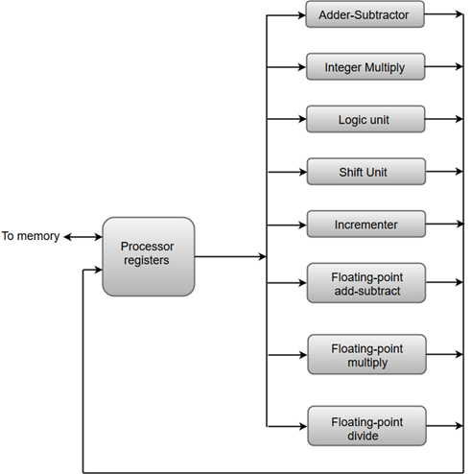
The adder and integer multiplier performs the arithmetic operation with integer numbers.
The floating-point operations are separated into three circuits operating in parallel.
The logic, shift, and increment operations can be performed concurrently on different data. All units are independent of each other, so one number can be shifted while another number is being incremented.

Slide 4
Types of Parallel processing
SISD
SIMD
MISD
MIMD

Slide 5
Pipelining:-
Pipelining is the process of storing and prioritizing computer instructions that the processor executes. The pipeline is a "logical pipeline" that lets the processor perform an instruction in multiple steps. The processing happens in a continuous, orderly, somewhat overlapped manner.
In computing, pipelining is also known as pipeline processing. It is sometimes compared to a manufacturing assembly line in which different parts of a product are assembled simultaneously, even though some parts may have to be assembled before others. Even if there is some sequential dependency, many operations can proceed concurrently, which facilitates overall time savings.
Pipelining creates and organizes a pipeline of instructions the processor can execute in paralle

Slide 6
Pipelining Process :-
The pipeline, each segment consists of an input register that holds data and a combinational circuit that performs operations. The output of the circuit is then applied to the input register of the next segment of the pipeline. Here are the steps in the process:
Fetch instructions from memory.
Read the input register, and decode the instruction.
Execute the instruction.
Access an operand in data memory.
Write the result of the operation into the input register of the next segment.

Slide 7
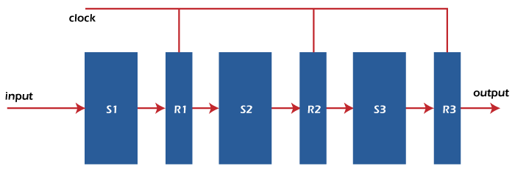
clock
Output
Input

Slide 8
Types of pipelines
There are two types of pipelines in computer processing.
Instruction pipeline
The instruction pipeline represents the stages in which an instruction is moved through the various segments of the processor, starting from fetching and then buffering, decoding and executing. One segment reads instructions from the memory, while, simultaneously, previous instructions are executed in other segments. Since these processes happen in an overlapping manner, the throughput of the entire system increases. The pipeline's efficiency can be further increased by dividing the instruction cycle into equal-duration segments.
Arithmetic pipeline
The arithmetic pipeline represents the parts of an arithmetic operation that can be broken down and overlapped as they are performed. It can be used for used for arithmetic operations, such as floating-point operations, multiplication of fixed-point numbers, etc. Registers are used to store any intermediate results that are then passed on to the next stage for further processing.

Slide 9


Throughput & Speed :-
Throughput = Number of instruction / Total time to complete the instruction

Slide 10
Pipeline Hazards
What are Pipeline Hazards?
As we all know, the CPU’s speed is limited by memory. There’s one more case to consider, i.e. a few instructions are at some stage of execution in a pipelined design. There is a chance that these sets of instructions will become dependent on one another, reducing the pipeline’s pace. Dependencies arise for a variety of reasons, which we will examine shortly. The dependencies in the pipeline are referred to as hazards since they put the execution at risk.
A hazard, in essence, prevents an instruction present in the pipe from being performed during the specified clock cycle. Since each of the instructions may be in a separate machine cycle, we use the term clock cycle.
Types of Pipeline Hazards in Computer Architecture
The three different types of hazards in computer architecture are:
1. Structural
2. Data
3. Control

Slide 11
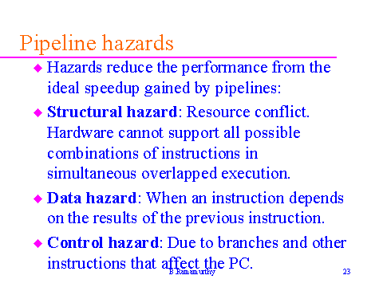

Slide 12

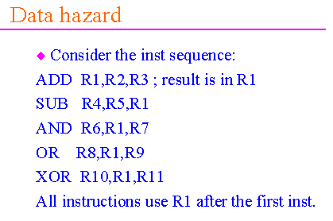
Examples of Hazard:-

Slide 13
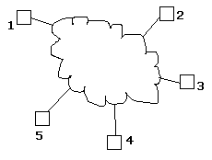
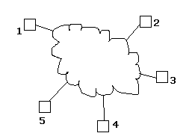
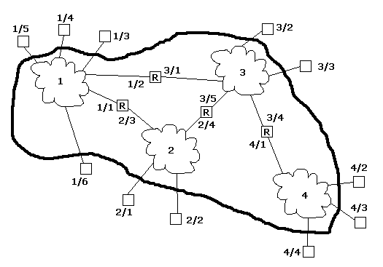
Introduction to Networks :-
A network: A group of devices that can communicate with each other over links. Each device is called a host. Each host has a unique address.
An internet: A network of networks. On an internet, each host has an address of the form n/h where n is the network number and h is the number of the host on network n. As long as all of the networks in the internet have unique network numbers, combining the network number and host number will give unique global names. Therefore from the outside an internet looks like a single network!
A router: A device that appears simultaneously on two or more networks. (Usually this is a computer or device with two or more network interface cards, or NICs.)
A network: A group of devices that can communicate with each other over links. Each device is called a host. Each host has a unique address.
An internet: A network of networks. On an internet, each host has an address of the form n/h where n is the network number and h is the number of the host on network n. As long as all of the networks in the internet have unique network numbers, combining the network number and host number will give unique global names. Therefore from the outside an internet looks like a single network!

Slide 14
Cache coherence:-
In a shared memory multiprocessor system with a separate cache memory for each processor, it is possible to have many copies of shared data: one copy in the main memory and one in the local cache of each processor that requested it. When one of the copies of data is changed, the other copies must reflect that change. Cache coherence is the discipline which ensures that the changes in the values of shared operands (data) are propagated throughout the system in a timely fashion.
In computer architecture, cache coherence is the uniformity of shared resource data that ends up stored in multiple local caches. When clients in a system maintain caches of a common memory resource, problems may arise with incoherent data, which is particularly the case with CPUs in a multiprocessing system.

Slide 15
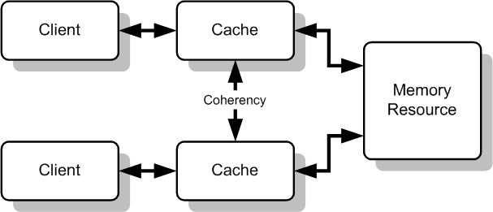
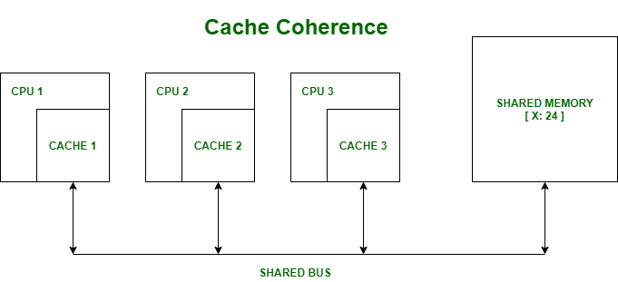

Slide 16
tq

